Slide 1

Intelligent Quantitative Stock Recommendation System
“Your Personalized AI Investment Laboratory”
By Team 7

Slide 2
1. Strategies

Slide 3
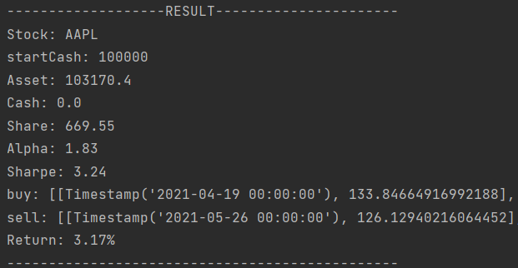
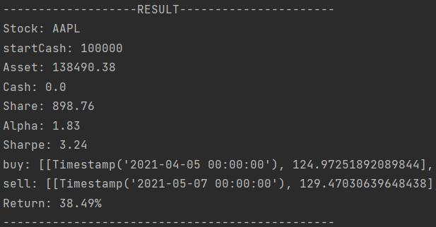
MACD
To find how long is the short term and long term: train method
default parameter
Set default parameter
Try parameters by possible random number
best parameter
if the back test result is better
if not
Iterate to get better parameters

Slide 4
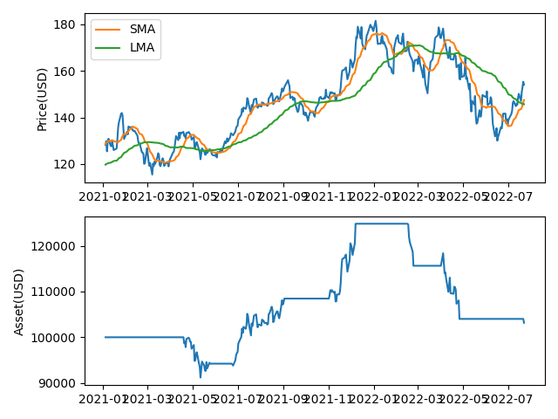
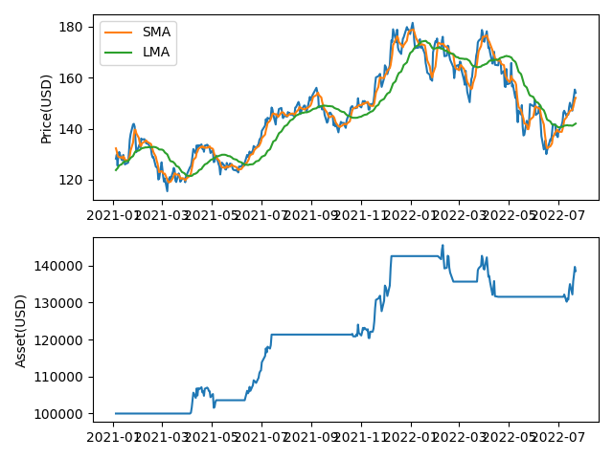
MACD：related plots
default parameter
best parameter

Slide 5
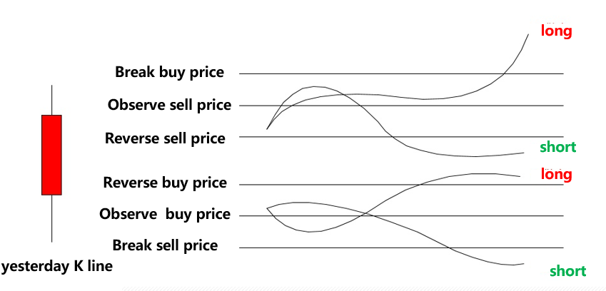
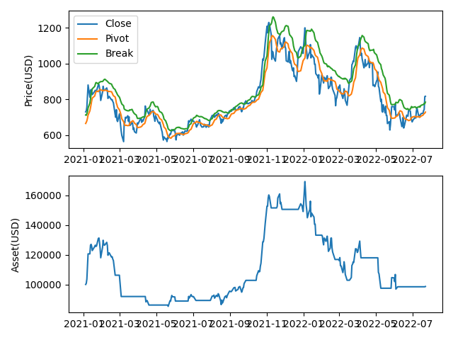
R-Breaker
Strategy
plot

Slide 6
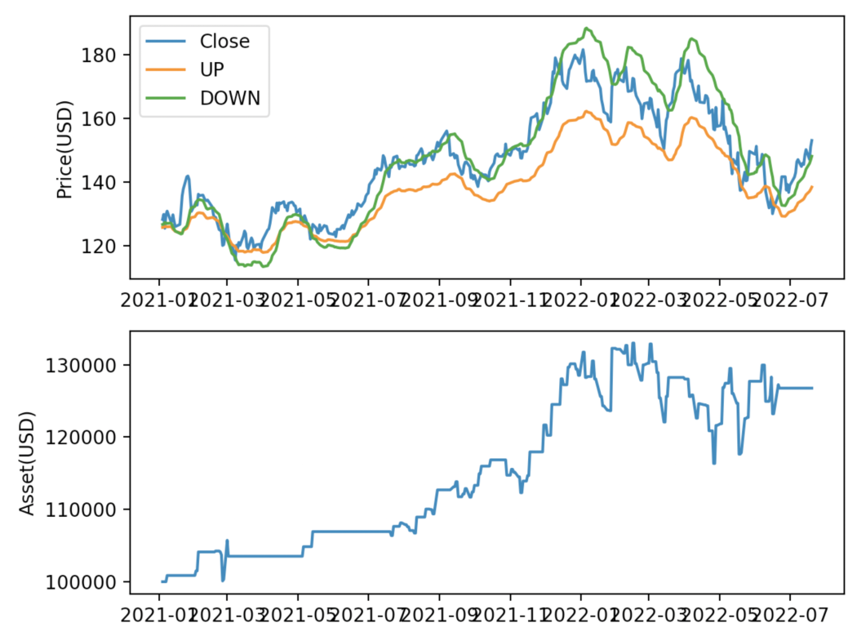
Boll Channel Strategy
If stock price break UP and DOWN(price±X*std, X is parameter), long the stock
example plot
Flexibility
Intuitiveness
Tendency

Slide 7
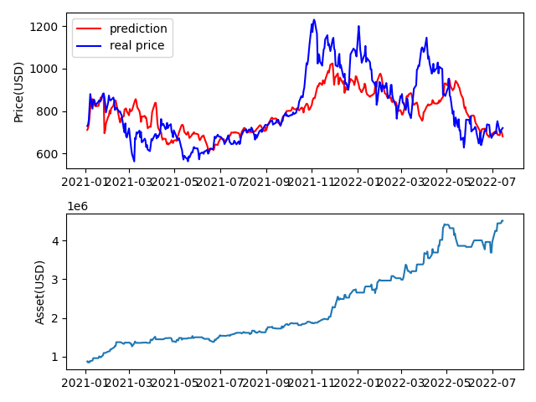
LSTM
Set back test period as testing set, set previous time period as training and validation set
example plot

Slide 8
2. NLP Emotion Analysis

Slide 9
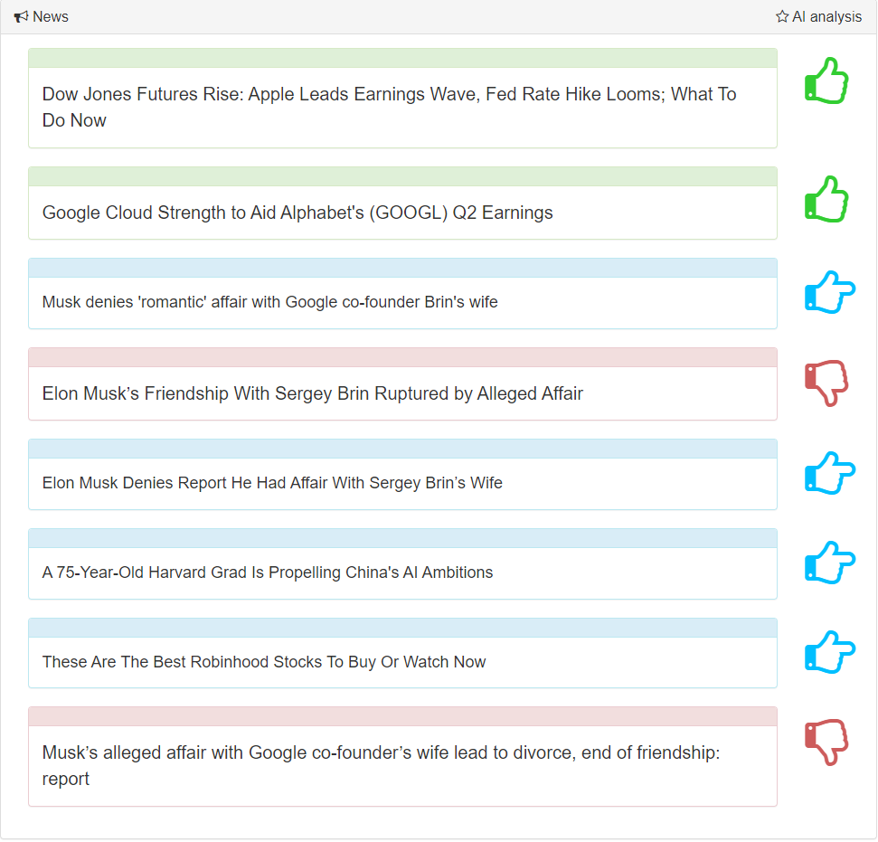
NLP Emotion Analysis: Introduction

Slide 10
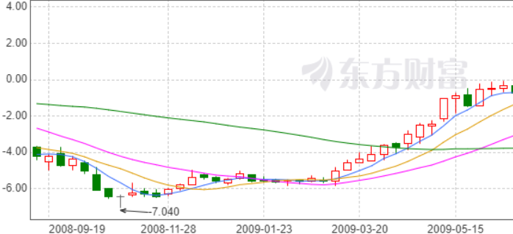
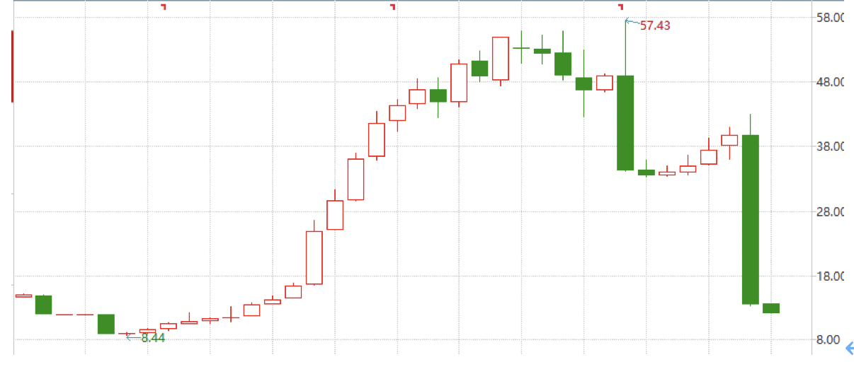
NLP Emotion Analysis: Introduction
announce the merger event
fined for manipulating the market
News is important for predicting stock prices!

Slide 11
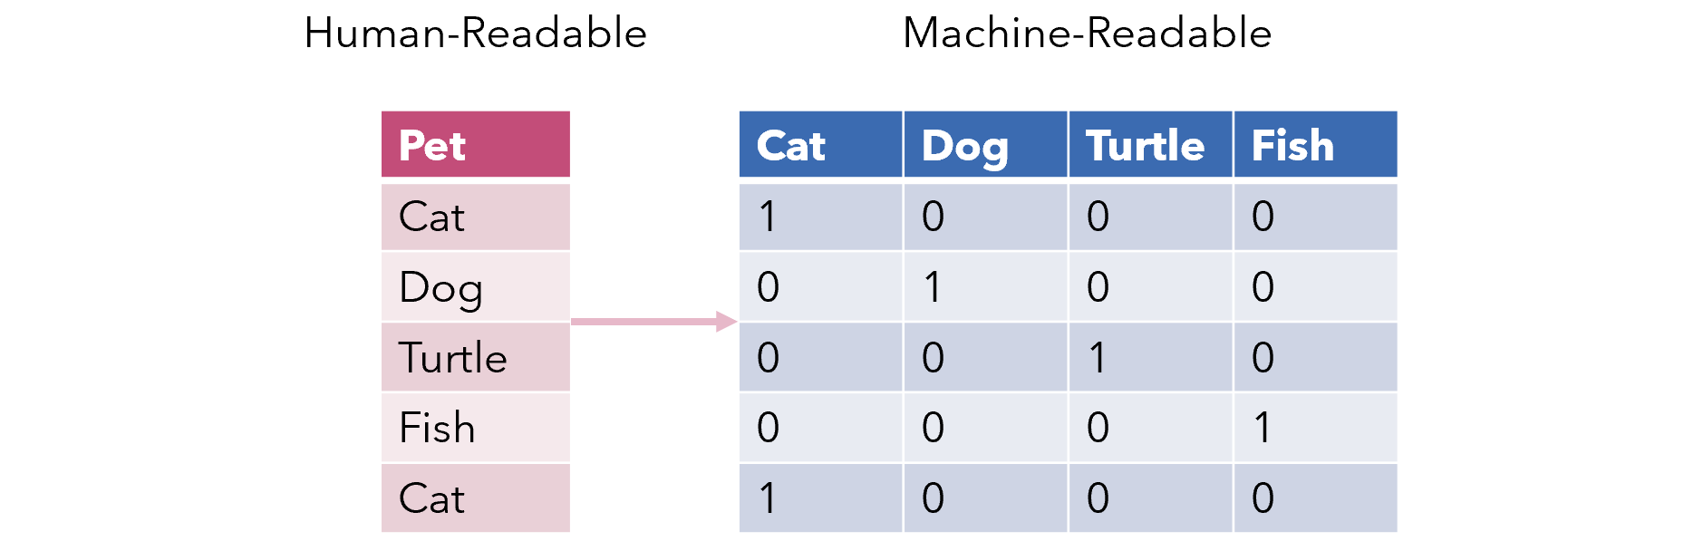

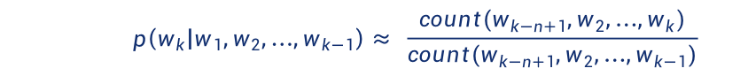
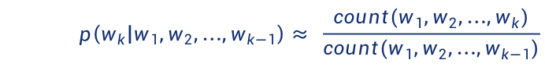
NLP Emotion Analysis: Models
One hot encoding
n-gram Word2Vec √
By Bayes,
$$p\left(w_{k} | w_{1},w_{2},{…,w}_{k−1}\right)= \frac{p(w_{1},w_{2},…,w_{k})}{p(w_{1},w_{2},…,w_{k−1})}$$
By law of large numbers,
$$p\left(w_{k} | w_{1},w_{2},{…,w}_{k−1}\right)≈ \frac{count(w_{1},w_{2},…,w_{k})}{count(w_{1},w_{2},…,w_{k−1})}$$
By n-1 order Markov Assumption,
$$p\left(w_{k} | w_{1},w_{2},{…,w}_{k−1}\right)≈ p\left(w_{k} | w_{k−n+1},w_{2},{…,w}_{k−1}\right)$$
Occupy a lot of computing time and memory space!
So that,
$$p\left(w_{k} | w_{1},w_{2},{…,w}_{k−1}\right)≈ \frac{count(w_{k−n+1},w_{2},…,w_{k})}{count(w_{k−n+1},w_{2},…,w_{k−1})}$$

Slide 12

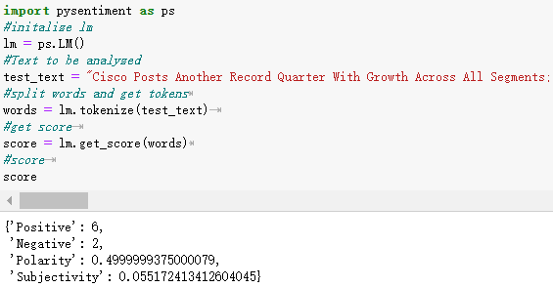
NLP Emotion Analysis: Models
Random Forest
Loughran & McDonald Sentiment Word Dictionary
Dictionary
Final-Class

Slide 13
3. Design & Develop

Slide 14
Contents
Learning experience
Schedule
Design & Develop experience
Full stack design & develop
Incompatible interface
Database redundancy
The most complex front-end processing
The most complex back-end processing

Slide 15
Learning Experience

Slide 16
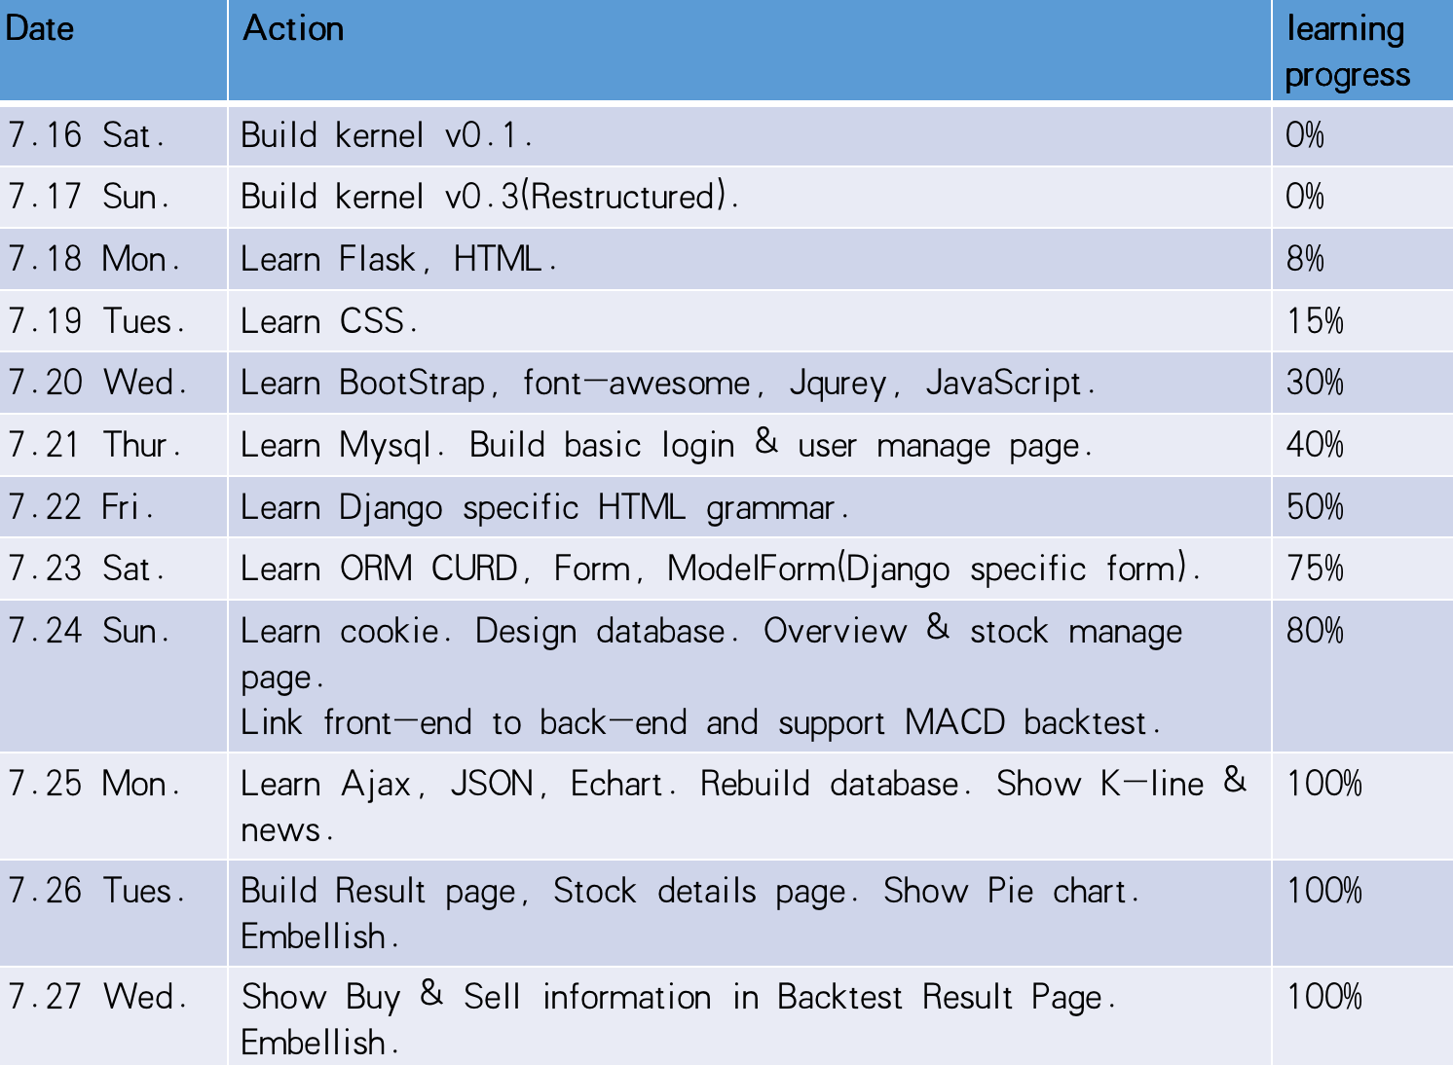
My Schedule

Slide 17
Design & Develop Experience

Slide 18
Full Stack Design & Develop
Frontend
HTML/CSS/
BootStrap/
JS/JQurey
GET/POST
Django ORM
Table.objects.all()
<QuerySet>
CURD
Local Database
MySQL
Ajax/JSON
Data
JSON.parse(str)
Call
Manage
Database
Data
Kernal
StrategyLib
LSTM
NLP
Backend
Python
Django
Parameters & Data
Result

Slide 19
Incompatible Interface

Slide 20
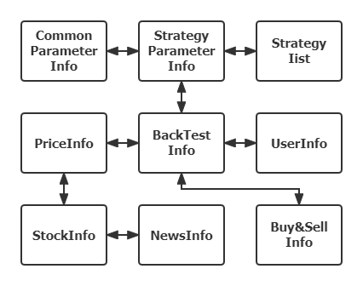
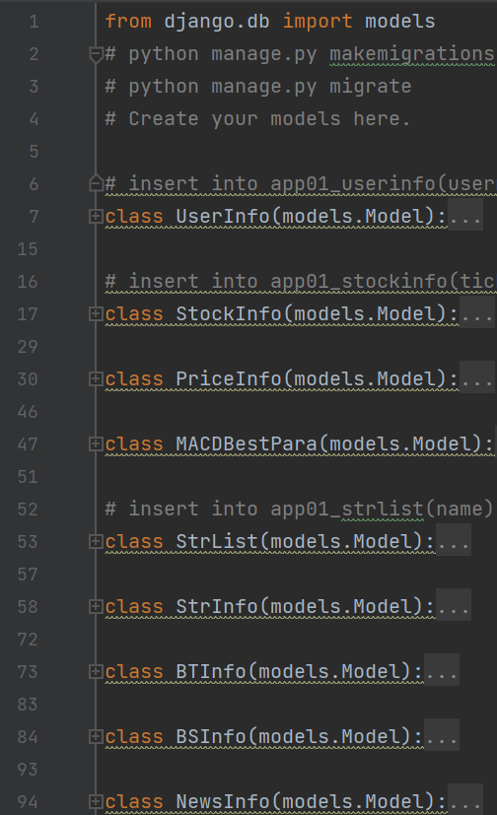
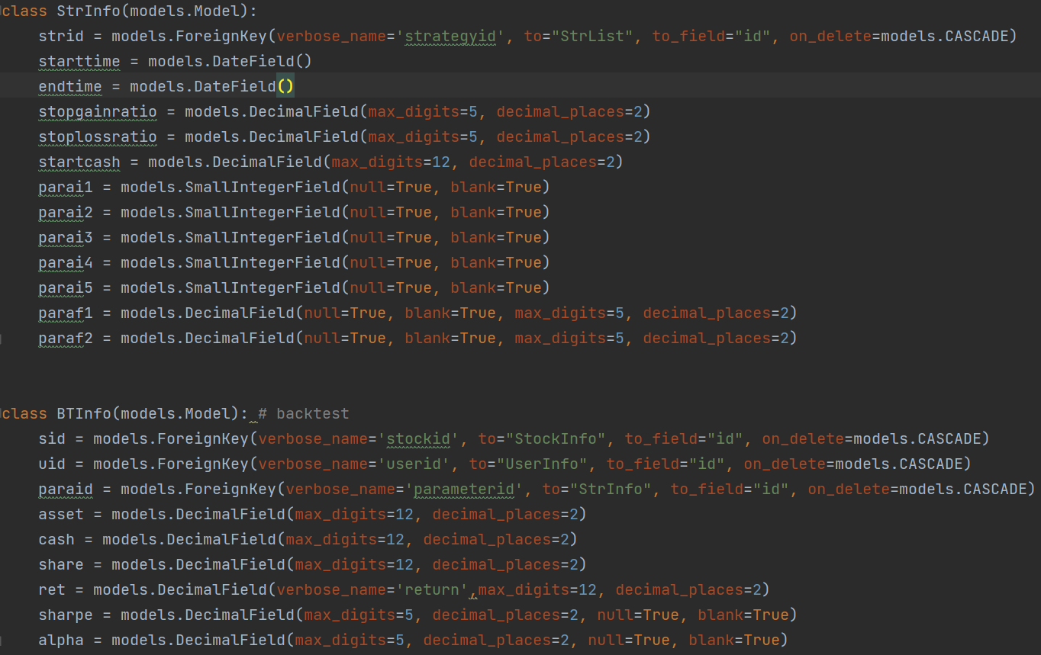
Database Redundancy

Slide 21
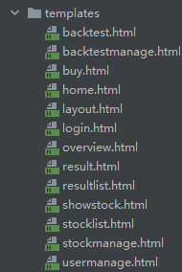
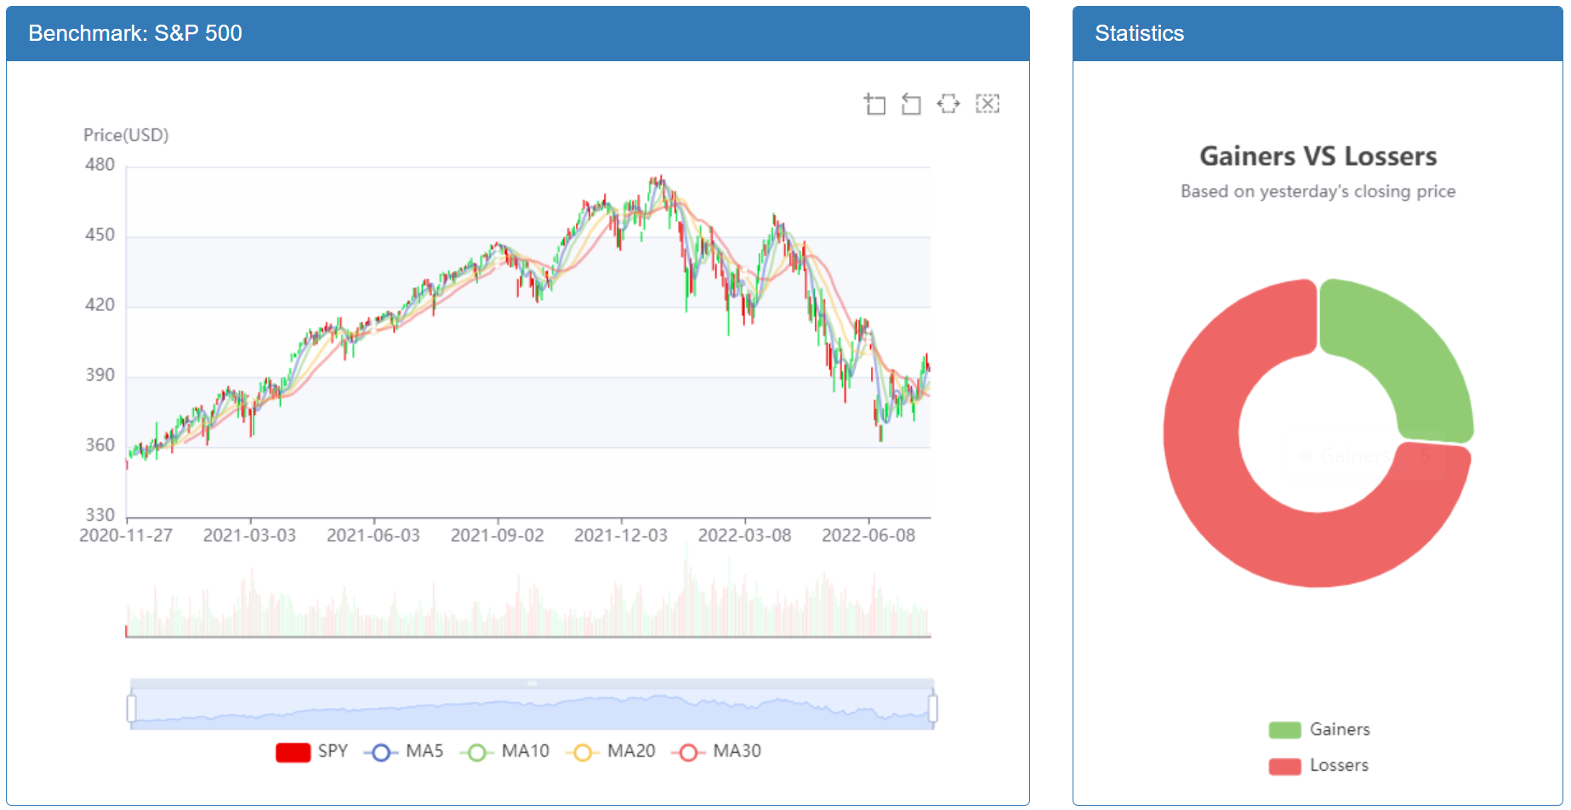
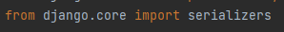
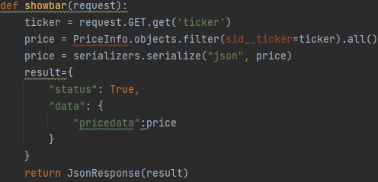
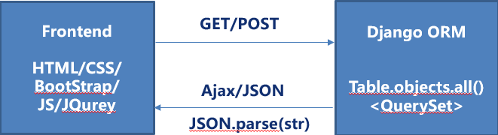
The Most Complex Front - end Processing

Slide 22
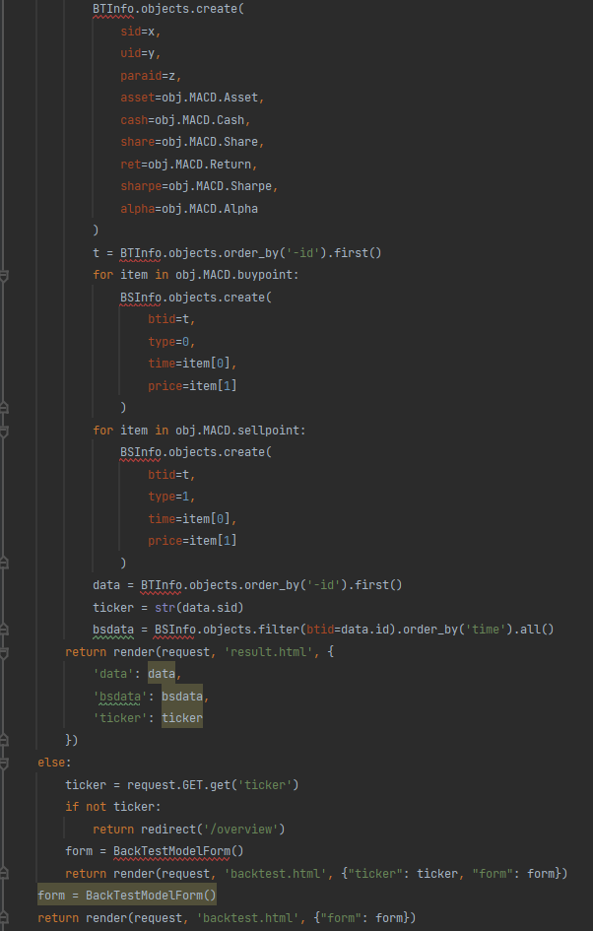
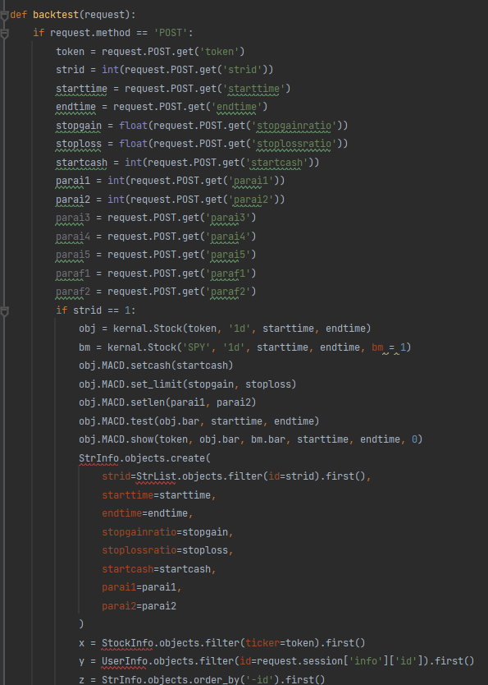
The Most Complex Back - end Processing

Slide 23
Thank you for your listening !
By Team 7

